Slide 1

The AEC Trifecta: Uniting AI, Digital Twins, and BIM for Smarter Building
Transforming the architecture, engineering, and construction industry through the convergence of three revolutionary technologies
Source: InnovateEnergy | Published: November 26, 2024

Slide 2



The Technology Trinity
Building Information Modeling
Digital Twins
Artificial Intelligence
Dynamic, data-driven replicas of physical assets providing real-time monitoring, predictive maintenance, and comprehensive lifecycle management capabilities
The next frontier revolutionizing every construction stage through design optimization, predictive analytics, and automated decision-making processes
The foundation: evolved from static 2D drawings to dynamic 3D models enabling enhanced collaboration, visualization, and coordination across project lifecycles

Slide 3
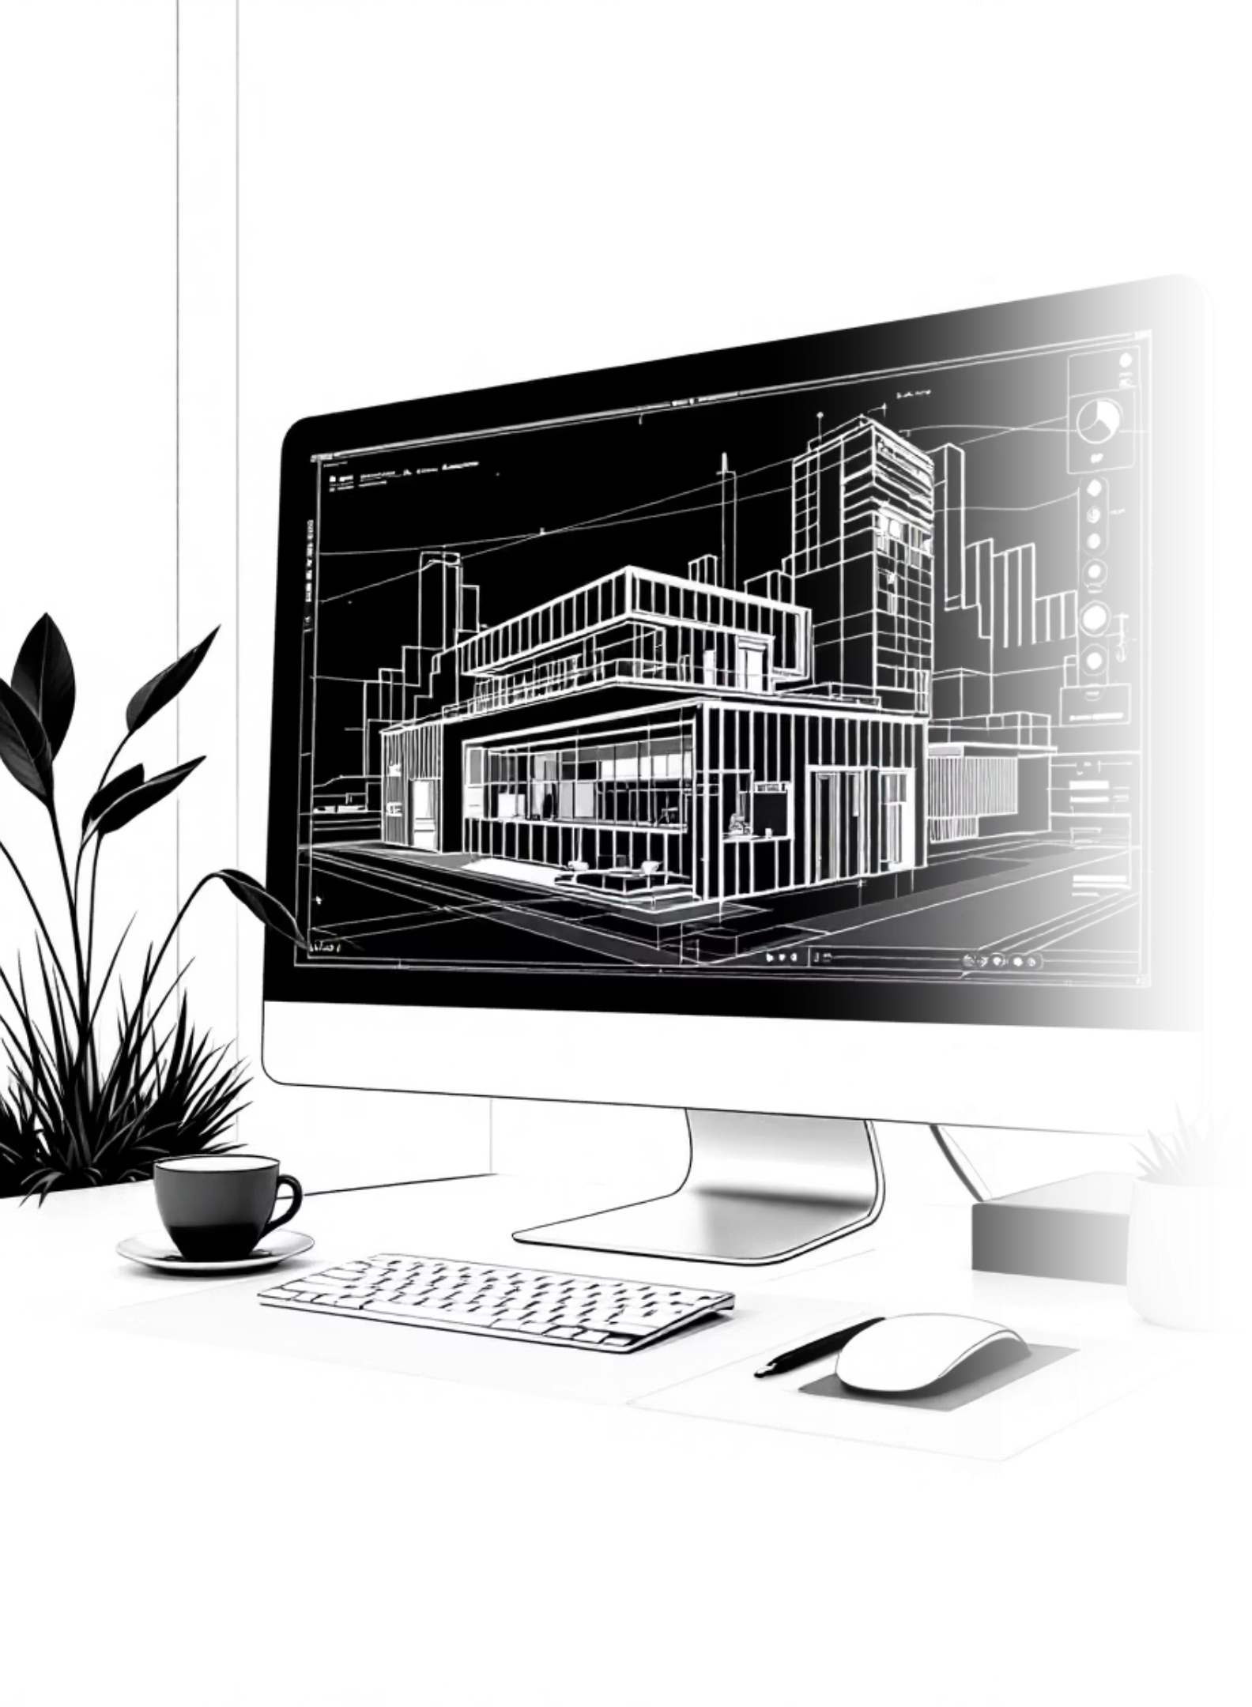
BIM: The Foundation Technology
Evolution Journey
Unlocked Capabilities
Transformed industry for over two decades
Robotic on-site layout systems
Advanced prefabrication processes
Advanced from static 2D to dynamic 3D models
Integration with 3D printing technology
Enhanced collaboration and visualization

Slide 4
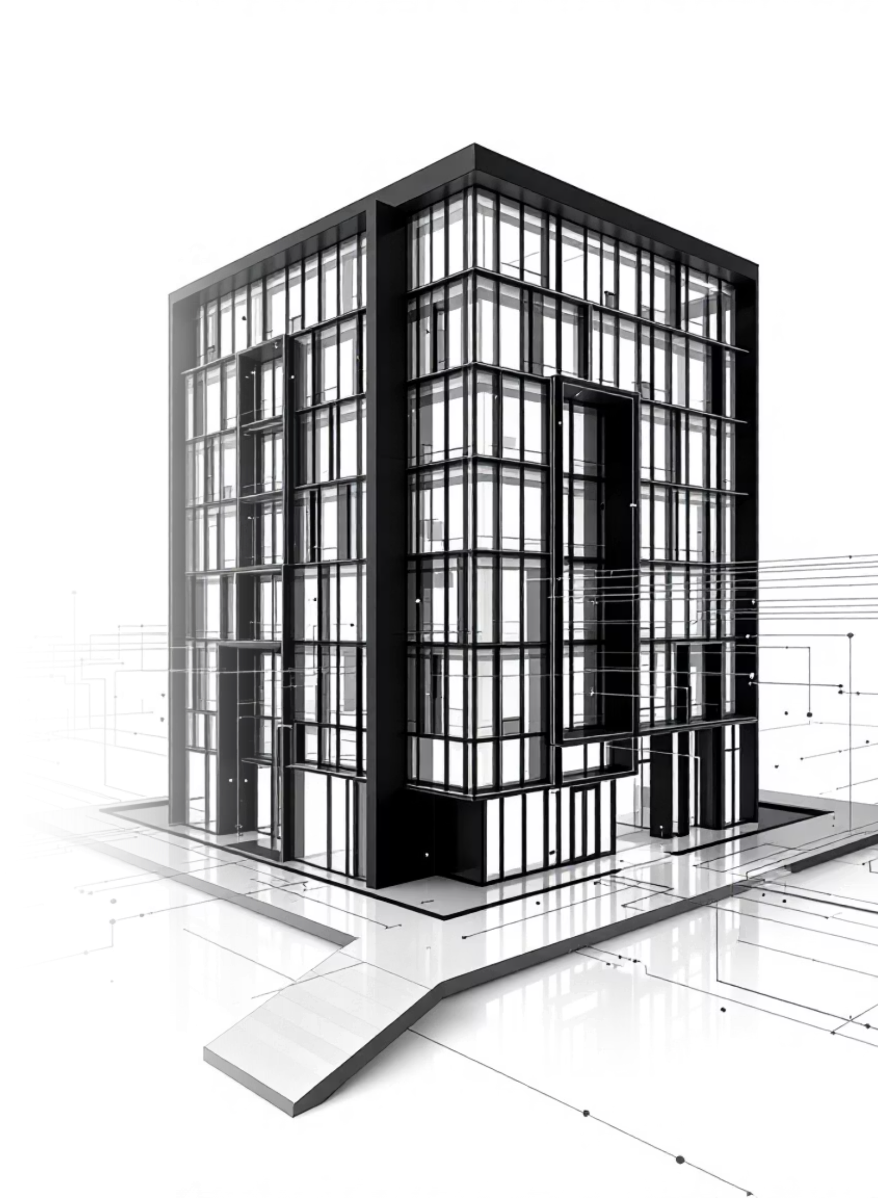



Digital Twins: Real-Time Intelligence
Real-Time Monitoring
Predictive Maintenance
Continuous data collection from physical assets enables immediate performance insights and operational awareness
Advanced analytics identify potential issues before they occur, reducing downtime and maintenance costs
Lifecycle Management
Comprehensive asset management from design through operations, maximizing building performance and longevity

Slide 5
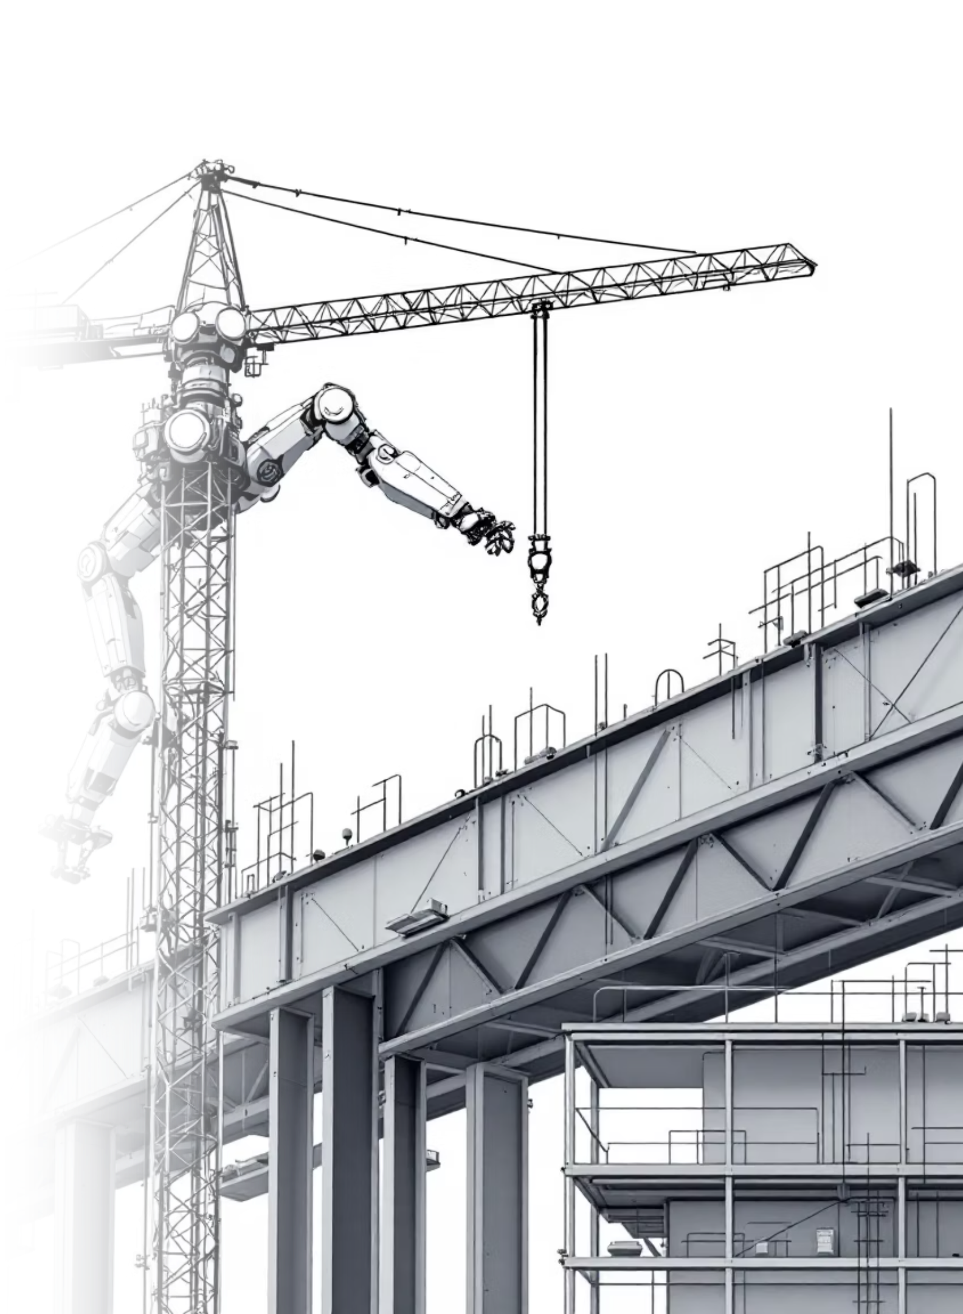
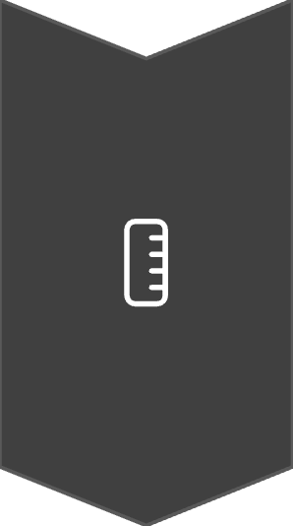


AI: The Next Frontier
Design Optimization
Generative design software and automated processes enable architects to explore innovative solutions while focusing on creativity
Predictive Analytics
AI-driven insights optimize construction schedules, resource allocation, and risk management throughout project execution
Intelligent Workflows
Embedded AI tools automate repetitive tasks and enhance decision-making across all construction lifecycle stages

Slide 6
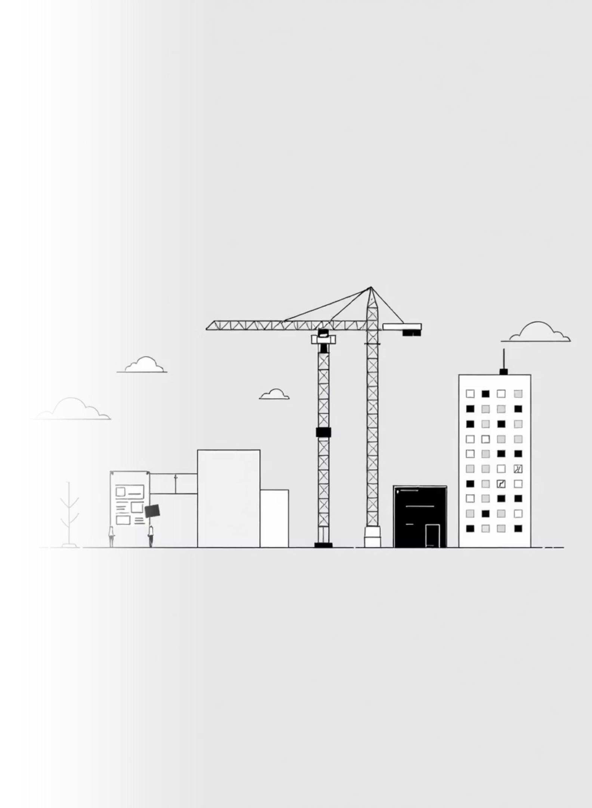
Convergence Benefits Across Project Phases
1
Design Phase
AI and BIM automate repetitive tasks while digital twins provide real-time design feedback, enabling focus on innovation and creativity
2
Construction Phase
AI-powered analytics optimize schedules and resource allocation while digital twins deliver live progress monitoring and coordination
3
Operations Phase
Digital twins combined with AI enable predictive maintenance, reducing downtime and extending asset lifespans significantly

Slide 7
Industry Transformation Impact
5
Key Impact Areas
Process optimization streamlining workflows from design through operations
1
Enhanced Collaboration
2
Predictive Capabilities
Breaking down information silos between project stakeholders for seamless communication
Proactive maintenance and issue identification before problems impact operations
3
Automation Integration
4
Data-Driven Decisions
Reduced manual tasks and increased precision throughout construction processes
Leveraging high-quality datasets for informed choices and strategic planning

Slide 8

Challenges and Implementation Strategy
Key Challenges
Success Strategy
Substantial investment in infrastructure and training
Start small with pilot projects
Allow teams to experiment and build confidence
Cultural change management requirements
Foster collaboration between stakeholders
Data security and standardization concerns
Phased approach to technology adoption
Interoperability between systems

Slide 9

The Future Vision
"A construction industry where AI, digital twins, and BIM work in harmony to create more efficient, sustainable, and innovative building processes"
Seamless Information Flow
Smarter Building Era
Moving beyond traditional processes into intelligent, data-driven construction methodologies
Breaking down traditional silos for enhanced collaboration throughout project lifecycles
Sustainable Innovation
Creating a more efficient and environmentally conscious built environment for the future

Slide 10
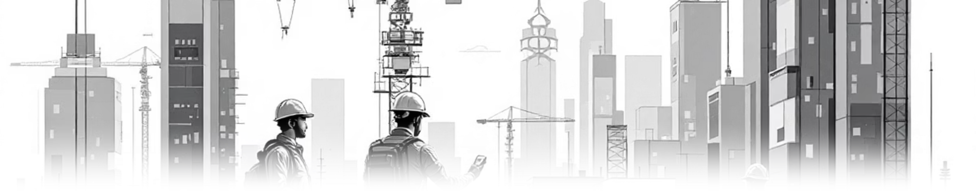
Key Takeaways
1
2
3
Technology Convergence is Here
Phased Implementation Works
Industry Transformation Ahead
The integration of AI, digital twins, and BIM represents a paradigm shift toward smarter building practices
Success requires starting small, building confidence, and fostering collaboration across all stakeholders
The AEC industry is moving into an era of enhanced efficiency, sustainability, and innovation through technology
Ready to embrace the AEC trifecta? The future of construction is intelligent, connected, and transformative.

